Slide 1
Image-Based Situation Awareness
Sakari Lampola

Slide 2
Sakari Lampola
Master of Science 1983 (TTKK, system theory)
TTKK 1980-1983 (assistant, researcher)
Tampereen Sähkölaitos 1980-1982 (student trainee)
Imatran Voima 1984-1988 (group leader)
Kymenlaakso University of Applied Sciences 1988-1991 (teacher)
Oy Cybersoft Ab 1989-2012

Slide 3
Understanding Image

Slide 4
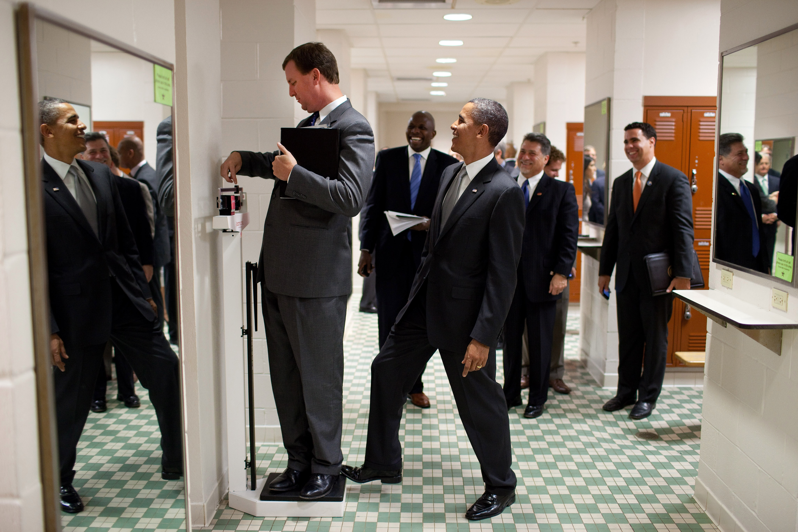

Slide 5
Image Captioning

Slide 6
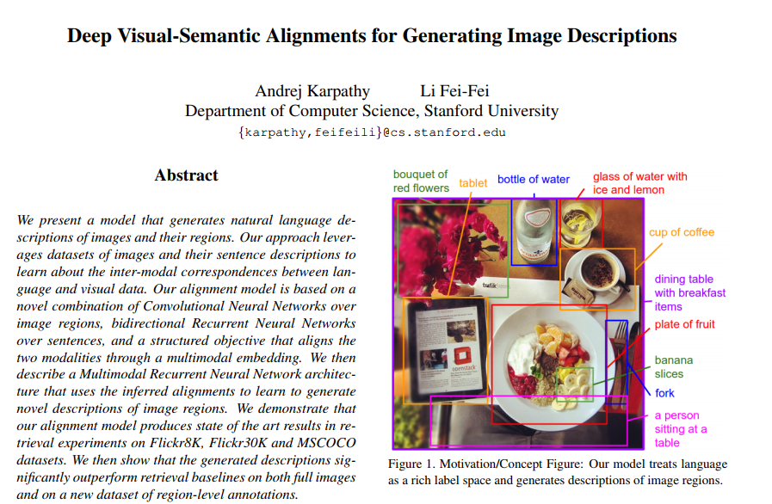
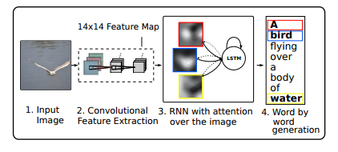

Slide 7
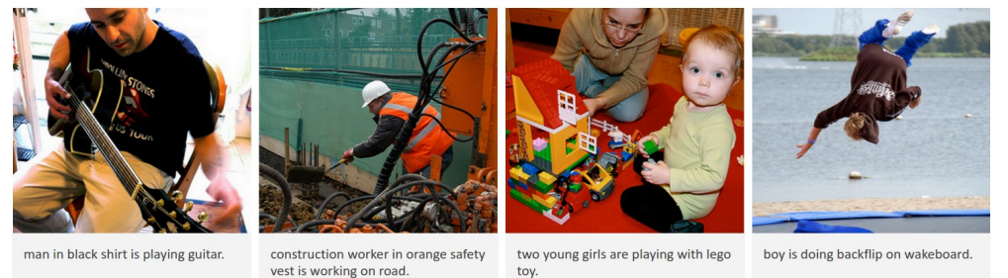
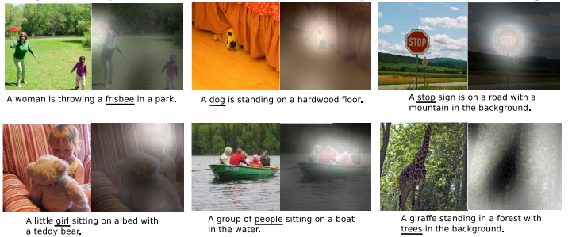

Slide 8
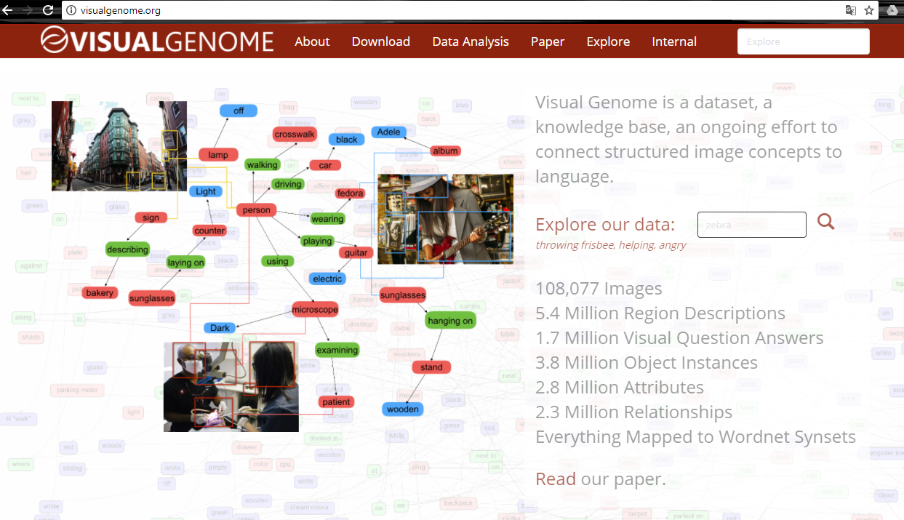

Slide 9
Visual Question Answering

Slide 10
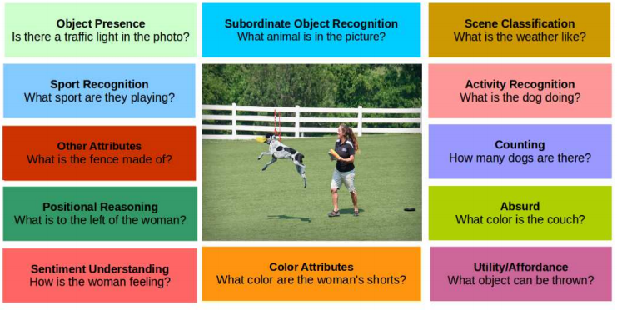

Slide 11
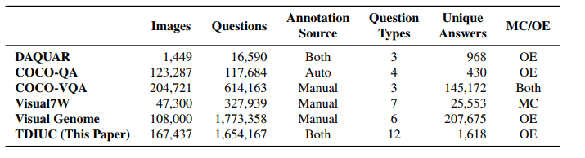
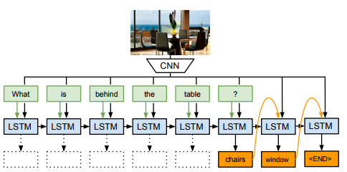

Slide 12
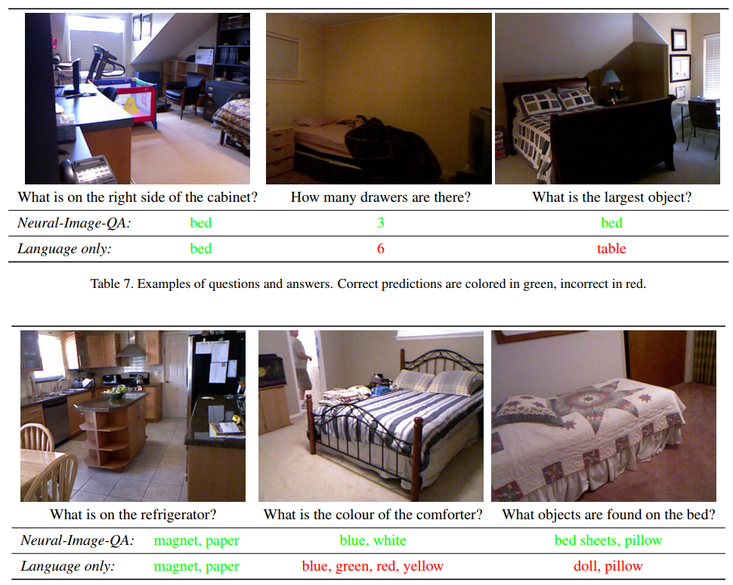

Slide 13
Visual Dialog

Slide 14
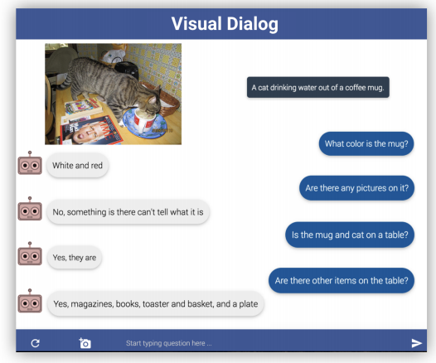

Slide 15
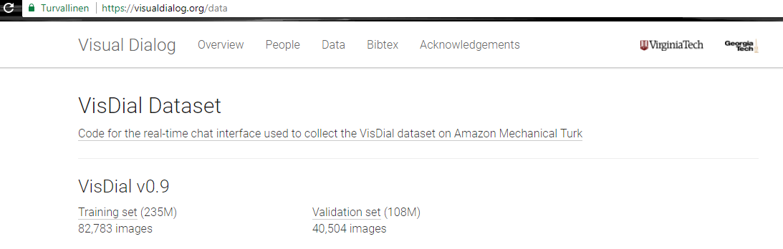
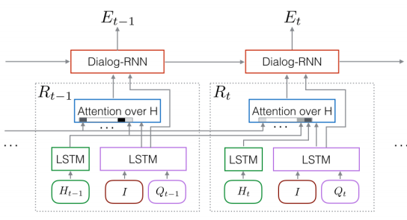
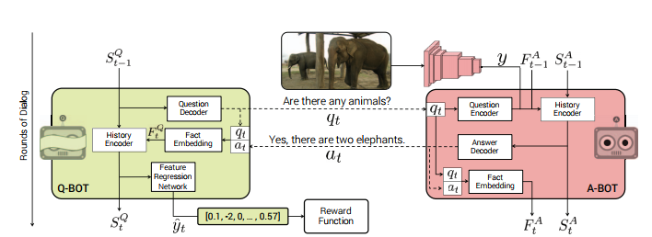

Slide 16
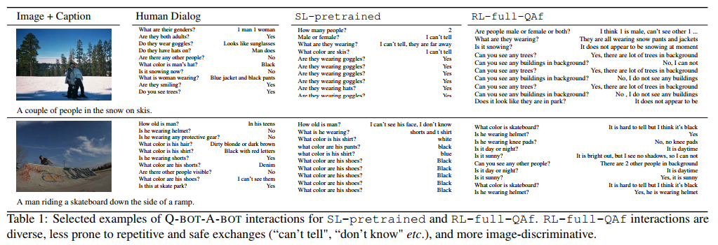

Slide 17
The Problem

Slide 18
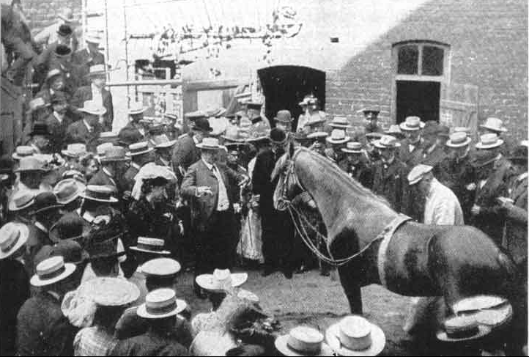
Clever Hans (by Larry Zitnick, 29.10.2017)

Slide 19
“A man on a scale...”
Mapping
Image
Language

Slide 20
Visual Reasoning

Slide 21
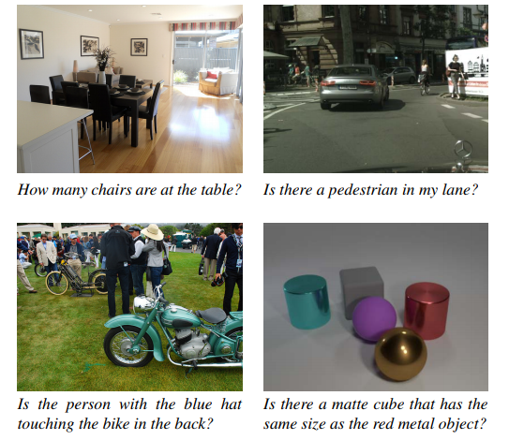
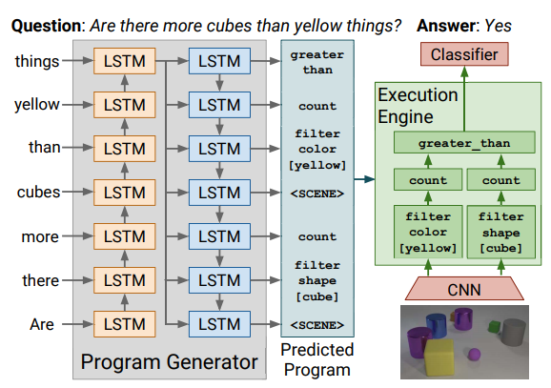

Slide 22
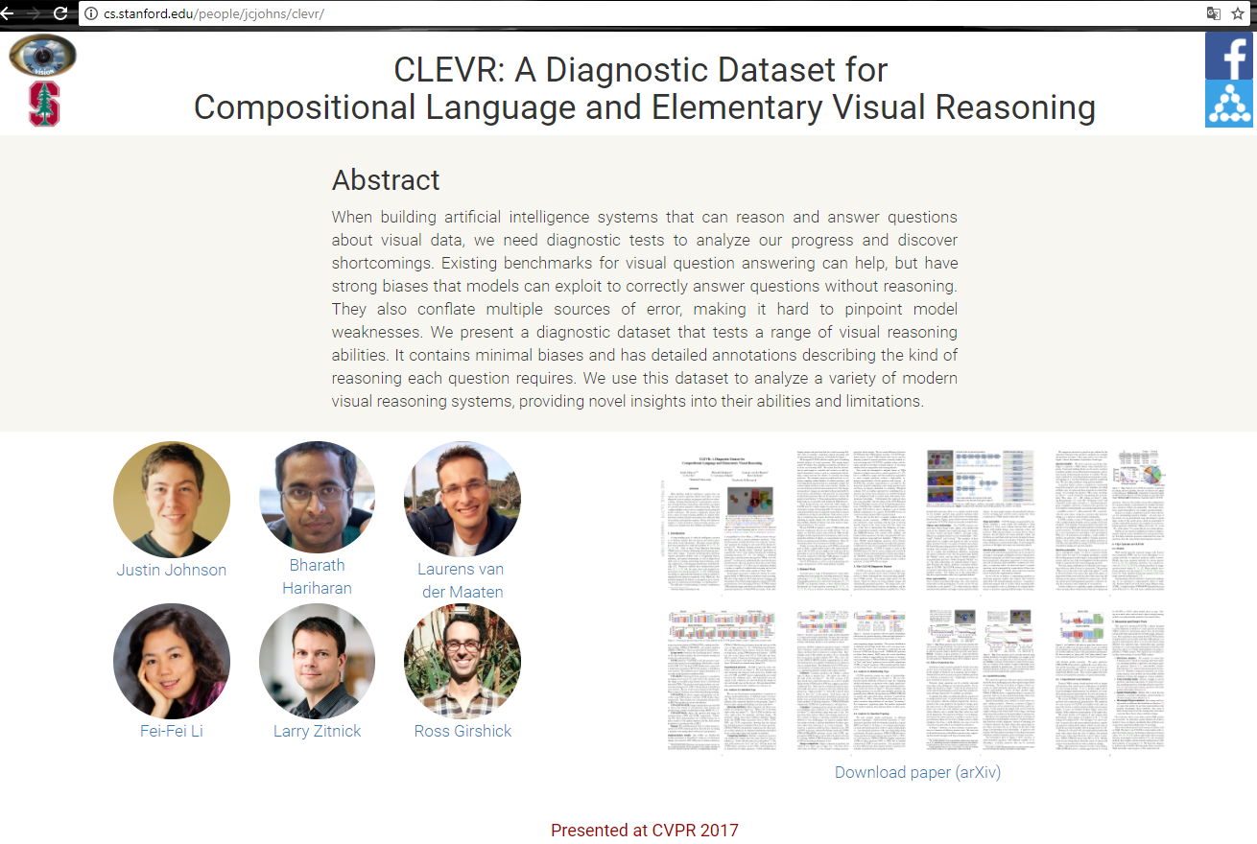

Slide 23
Thesis

Slide 24
Title: Image-Based Situation Awareness
Doctoral Progmamme: TUT Engineering Sciences, TTITO
Faculty: Department of Automation Science and Engineering
Supervisor: Professor Risto Ritala
Schedule: 2018-2021

Slide 25
Preliminary Work 2017
Richard Szeliski: “Computer Vision: Algorithms and Applications”
Sebastian Thrun, Wolfram Burgard, Dieter Fox: “Probabilistic Robotics”
Kevin P. Murphy: ”Machine Learning. A Probabilistic Perspective”
Stanford CS231n: ” Convolutional Neural Networks for Visual Recognition” (YouTube)
Udacity: ”Introduction to Computer Vision” (YouTube)
Udacity: ”Intro to Machine Learning” (YouTube)
Udacity: ”Machine Learning” (YouTube)
Udacity: ”Computational Photography” (YouTube)
Daphne Koller: ”Probabilistic Graphical Models” (YouTube)
Reviews on calculus, linear algebra, statistics, probability
Kaggle

Slide 26
Situation Awareness

Slide 27
Situation awareness
Perception of the elements in the current situation
Comprehension of the current situation
Projection of future status of the situation
N. A. Stanton, P. R. G. Chambers, and J. Piggott, “Situational awareness and safety,” Safety Sci., vol. 39, no. 3, pp. 189–204, 2001

Slide 28
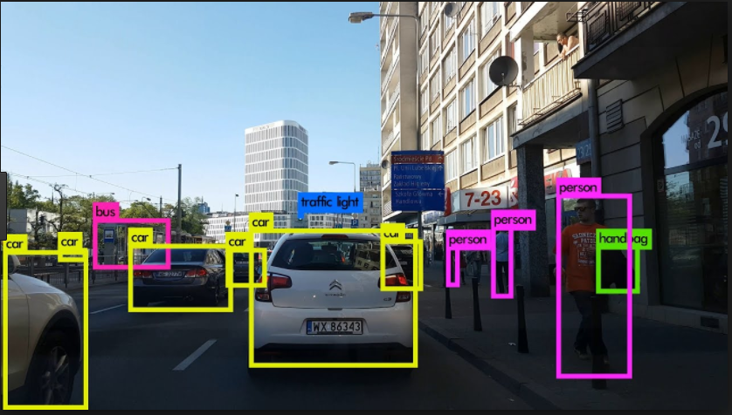
1. Perception of the elements in the current situation
Object detection
Algorithms:
Faster R-CNN
YOLO
SSD
…
Output
Classification
Bounding box
Reliability index

Slide 29
2. Comprehension of the current situation
Identifying objects in consecutive
Frames (multiple object tracking)
Algorithms:
BOOSTING
MIL
KCF
TLD
MEDIANFLOW
GOTURN

Slide 30
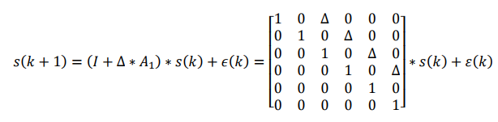
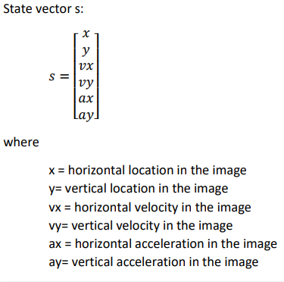
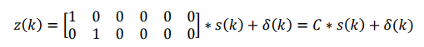
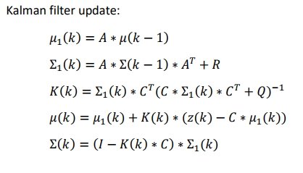
2. Comprehension of the current situation

Slide 31
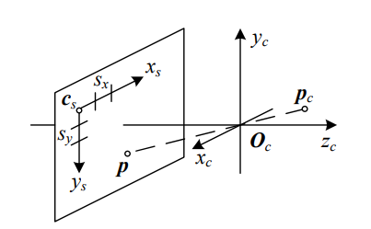
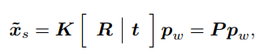
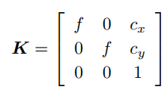
2. Comprehension of the current situation
From 2d to 3d

Slide 32
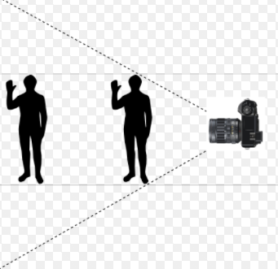
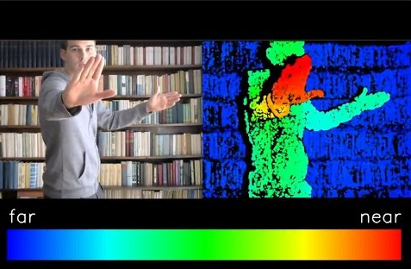
2. Comprehension of the current situation
Estimating distance
A priori size
Stereo vision

Slide 33
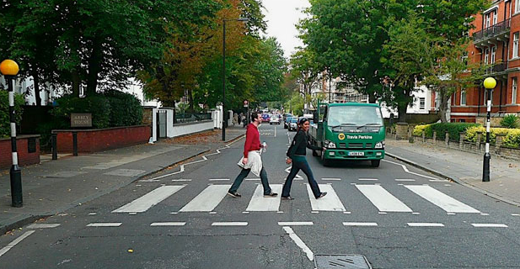
3. Projection of future status of the situation
”Two persons 4.5 meters away are crossing road from left to right. The road will be clear in 4 seconds. A truck is waiting on the right side.”
?

Slide 34
The Goal

Slide 35
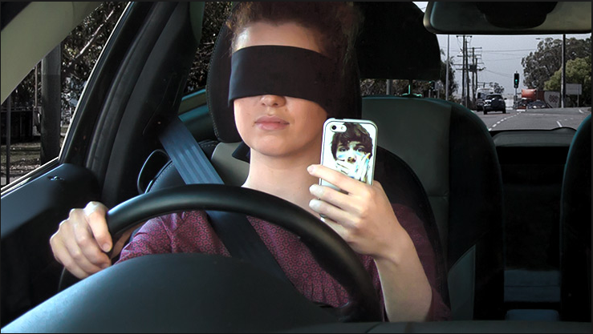

Slide 36
Research Objectives and Expected Results

Slide 37
Research Questions
By which methods an image-based perception of the environment can be produced, including object detection and localization in the field of view context?
By which methods a comprehension of the situation can be produced? This includes estimating object locations and their velocities in a 3d coordinate system, also for currently hidden objects.
By which methods a future projection of the situation can be created?
By which methods the comprehension and the future projection can be translated into human language?
How are uncertainty and reliability considered and represented?

Slide 38
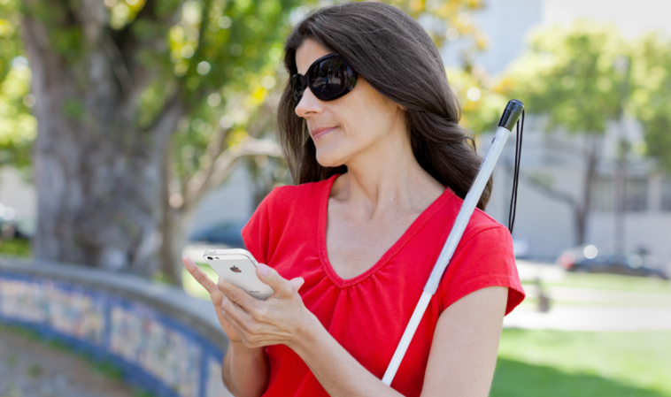
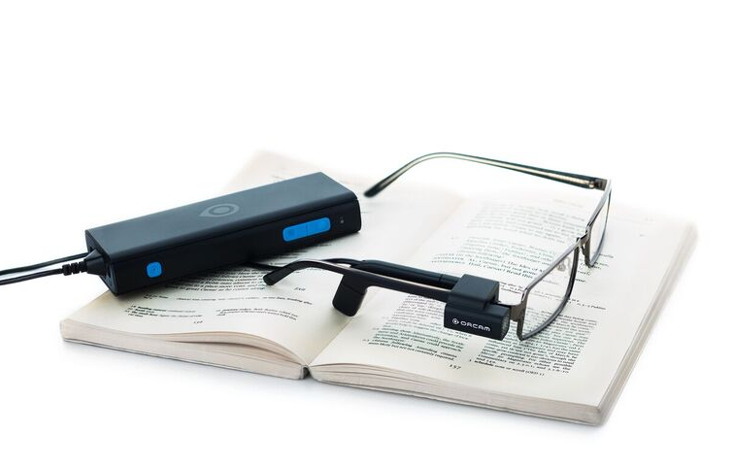
Prototype
OrCam MyEye 2.0
“For blind and partially sighted people, an artificial vision device with a lightweight smart camera that instantly reads text aloud - from any surface – and recognizes faces, products, and money notes in real time.”
Thesis Prototype
A reliable and fast system which can help a visually impaired person to understand her environment better by accurate and rich description. This is accomplished by
capturing images
detecting objects
comprehending situation
describing environment
projecting future
implying warnings
The system will be demonstrated on physical hardware, preferably mobile.

Slide 39
Schedule

Slide 40


Slide 41
Research Environment

Slide 42
Hardware
Intel i7-4790 4GHz / 16Gt Ram
NVIDIA GeForce GTX 780 Ti (CUDA)
Google Cloud Platform (if required)
Software
Matlab
Python
OpenCV
Tensorflow, Tensorflow Lite (if required)
PyTorch, Caffe2Go (if required)
Visual Studio (prototype user interface)

Slide 43
Questions ?

